Slide 1
DevSecOps & Automation Newsletter- May 2023

Slide 2
CONTENTS
Vision
Why DevSecOps?
2023 DevSecOps Progress
Success stories after Reassessment
What is Automation & Why?
Success stories after Reassessment [Automation]
Training and references

Slide 3
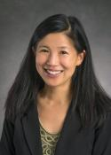



Vision
Implement Lean practices through DSO maturity coverage in Engineering and Product support (EP&S) and bringing IT Automation.
Increased operating speed and flexibility, release-on-demand, and first-time quality of secure-by-design applications.
Reduced hours and enable efficiency through automation

Slide 4
WHY DevSecOps ?

Slide 5
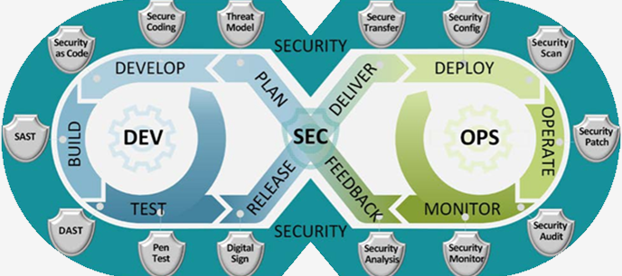
DevSecOps 2023
Implement Lean practices through DSO maturity coverage for 70% of high ROI products (~120 applications)and achieve overall DSO maturity level of 3+ . Complete assessments & re- assessments for 180+ applications for benchmarking and adding value to applications.
OKR
What is DevSecOps?
Implement lean Principled and bridges the gaps between development, security, and operations - continuous learning, collaboration, and security integration will yield shorter feedback loops, fewer bottlenecks, and fewer vulnerabilities.

Slide 6




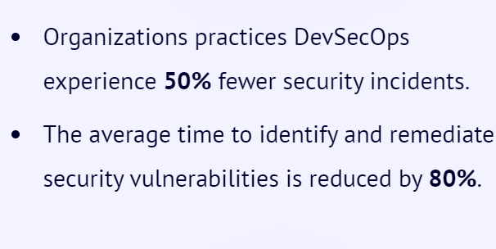
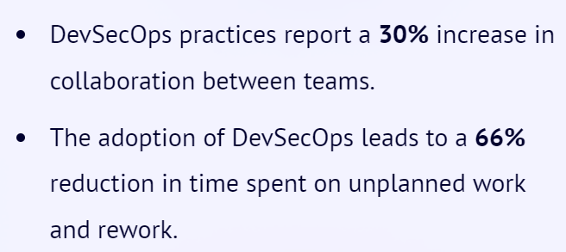
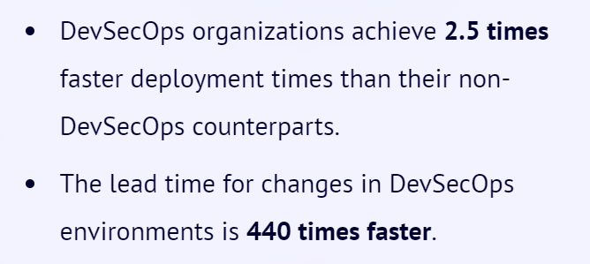
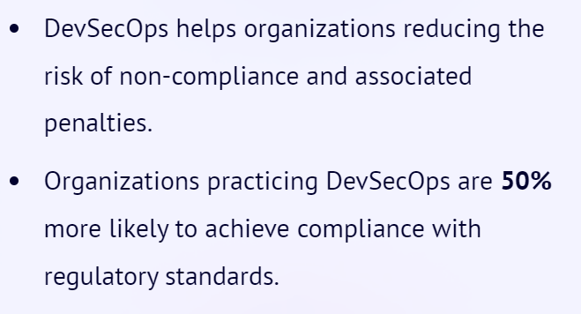
Why Implement DevSecOps?
Improved Security
Collaboration
Time to Market
Compliance
Notes:
Source:1) DevSecOps Community Survey
2) Puppet State of DevOps Report (https://www.puppet.com/resources/state-of-devops-report)

Slide 7
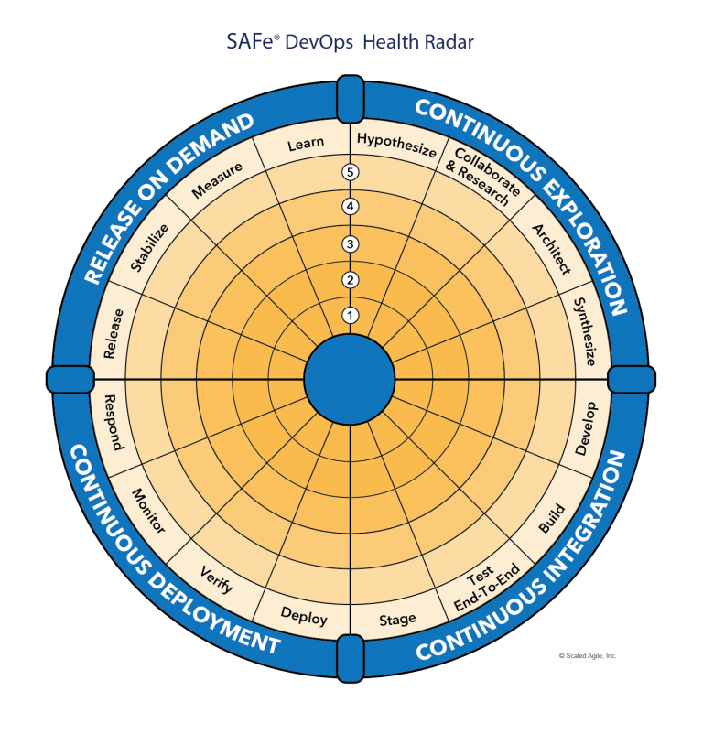
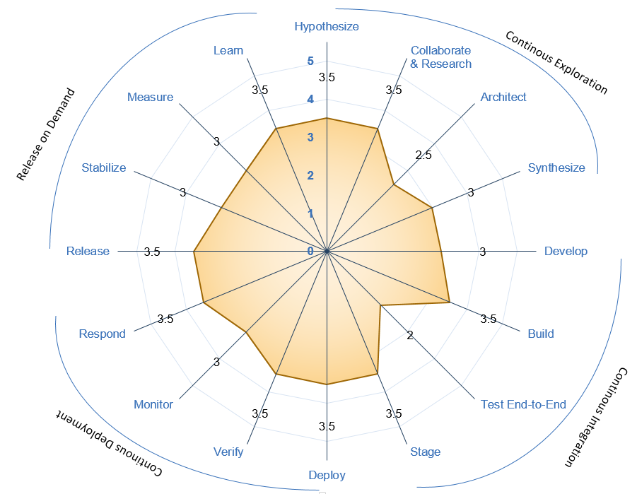





Understanding DevSecOps Maturity
Maturity Level | Stage | Stage Adoption | % of Adoption
Level 1 (Sit) | Initial | Yet to Start; Traditional environment and mindset | <=20%
Level 2 (Crawl) | Emerging | Beginning of change and agility; Initiated automation; | 21%-50%
Level 3 (Walk) | Practicing | Started Practicing; Transformation happening with defined process and automation | 51%-70%
Level 4 (Run) | Optimizing | High in Adoption ;Optimizing the existing practices and following Continuous improvement | 71%-90%
Level 5 (Fly) | Leading | Being a leader in adoption; | >90%
Recommended minimal level for DSO Adoption
Maturity Level
Sit
Level 1
Crawl
Level 2
Walk
Level 3
Run
Level 4
Fly
Level 5
1- Low & 5-High Maturity

Slide 8
Assessment Process
DevSecOps Assessment Process Flow (Swimlane)
Please refer to the attached PDF.
GSEP Process for Dashboard Access
Please use the link to get access to the assessment dashboard. This is an auto approval process. Please select the first option for Business Stakeholder group.
Try to access this Dashboard Link after few minutes.

Slide 9
2023 DSO progress

Slide 10
DevSecOps 2023
OKR
Implement Lean practices through DSO maturity coverage for 70% of High ROI products
Target
Complete DSO Assessments for new applications 120 Apps
[Overall – 280 apps (~30%) ]
Re-Assessments - 60 apps
Implementation roadmap for 40% Applications - 120 apps
[Overall – 200 (~20%) ]
Improved overall maturity to 3.0 from 2.8. Focus on High ROI and business critical Applications.
ROI Calculation - 50 Apps

Slide 11
Progress
On Track
Watch Item
Off Track
2023 OKR Targets
Q1
Q2
Target
Completed
Target
Completed
Complete DSO Assessments for new applications 120 Apps
30
34
30
18 + 81 AMaaS
Implementation roadmap for Applications that have completed assessments- 90 Apps
30
30
8 + 77 AMaaS
28
Roadmap implementation , Re-Assessment & ROI calculation for 15% Apps with roadmap created: - 40 apps
10
0
10
3
*DSO Improvements pending
*40 app reassessment in pipeline
Maturity improvement and maintain Score 3.0+
Maturity Score 3
Maturity Score 3

Slide 12
Success STORIES AFTER REASSESSMENT

Slide 13

Return on investments in 2023
8616 Hrs (As of May 2023)
40 Applications in pipeline for reassessment in 2023

Slide 14
CASTeam (Commercial Aviation Services Tool & Equipment Applications for Maintenance) Success stories (l3 to l4) Total Savings in a year 4047 hours = (102 Prod CI/cd + 3195 dev CI/CD + 750 coverity pipeline automation)
CI/CD
Development
3 Production Releases
Manual Effort = 4.5hrs
Automated = 0.25hrs
50+ Non Prod Deployments
(30 dev + 10 stage+10 test )
Per sprint (50 * 4.25) = 213hrs
23 to 84% Unit test Coverage improvement
Automated Protractor tests during Releases.
Coverity Pipeline savings
Per Sprint
( 50 scans * 1 hr) = 50 hrs

Slide 15
MIST – (Modular instrumentation setup tool) Success stories (l1 to l3) Total Savings In A Year 2304 hours = (1536 CI/cd + 768 development)
Configuration Management Practice followed which increases agility, both on the part of individual developers and the application as a whole.
Features:
Externalized
Environment Specific
Consistent
Version History
CI/CD
Development
4 Non-Production Deployment
Configuration Management Practice followed.
Manual Effort = 5 hr
Automated = 1.5 hr
Per Sprint(4env*4hr*8build=128 hr)
SAST tool in pipeline helps to ensure no new security vulnerabilities go to Production. Address security and quality defects early in the software development.
8 Story Point Task X 8 hrs = 64 hrs

Slide 16
GSESP (Ground Support Equipment supply partner) Success stories (l3 to l4) Total Savings in a year 2265 hours = (30 Prod CI/cd + 1710 dev CI/CD + 525 coverity pipeline automation)
CI/CD
Development
15 to 70% Unit test Coverage improvement for GSESP
Automated Protractor tests during Releases.
Coverity Pipeline savings
Per Sprint
( 35 scans * 1 hr) = 35 hrs
3 Production Releases
Manual Effort = 3.5hrs
Automated = 0.25hrs
35+ Non Prod Deployments
(25 dev + 5 stage+ 5 test )
Per sprint (35 * 3.25) = 114hrs

Slide 17
What IS AUTOMATION & why ?

Slide 18




Automation 2023
Implement automation capabilities through out the applications and achieve 80000 automation hours
OKR
Objective
Accomplishments:
Automate repetitive processes
Automation hours of 113602 has been accounted in the CoP.
Capture automation to Return On Investment.
Knowledge sharing and bring culture of Automation

Slide 19
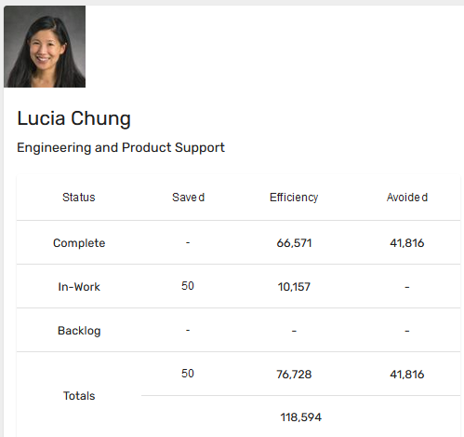
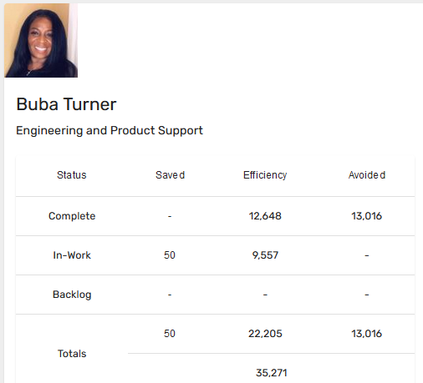
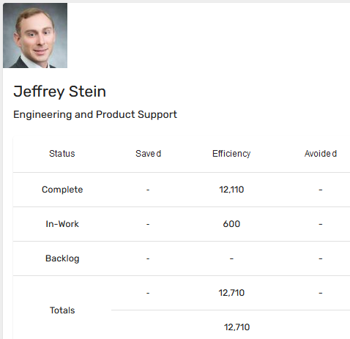
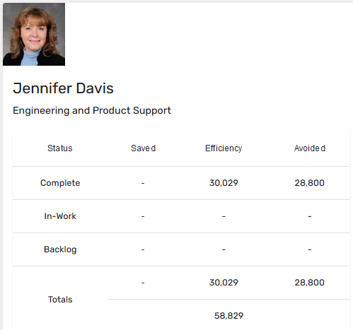
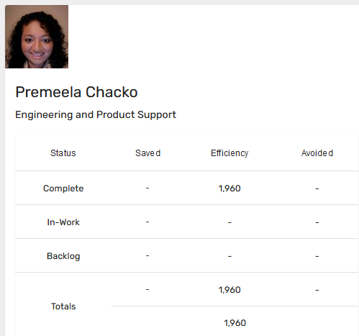
Automation Status - 2023
Target: 80k hrs
Current status: 118k hrs

Slide 20
Automation Q1 Status
URL | Project Name | Record Status | Efficiency
1 | DESE 3.3 Release Automation Savings | Complete | 2238
2 | Customer Engineering Production Release | Complete | 2003
3 | Boeing Predictive Assembly Technologies | Complete | 2417
4 | Functional Test Automation 3DExperience | Complete | 2780
5 | MBSI Software Express Deployment Automation | Complete | 320
6 | Flight Engineering and Propulsion Product Q1 Automation | Complete | 66
7 | SRP Gen Schedule and SRP Gen Template modules of BWS-CM | Complete | 120
8 | Automation of WIRS Application for Development and testing functionalities | Complete | 1360

Slide 21
Success STORIES AFTER REASSESSMENT

Slide 22
Automation Case study : 1
Project Name: Linux-based LDRA Licenses Implementation
Problem Statement: BFMS is working hard on their development productivity to meet 737MAX and FAA milestone schedules. They required more LDRA licenses as they were maxing out. Their current Windows-based LDRA licenses allowed them to perform instrumented builds weekly due to slow cycle time.
Solution: BFMS learned they could increase their team’s productivity by using Linux-based LDRA licenses, which cycled in a quarter of the time of Windows-based LDRA. This permits them to perform daily builds vs weekly and thus increase their output.
Automation Hours Calculation:
The calculations for the conversion of saved Automation hours to dollars is illustrated below:
Savings is 3 hours per build
BFMS has 80 engineers actively working on structural code coverage analysis on a daily basis by running the tests and making fixes to either the code and/or test procedures.
Hours saved formula: 80 users X 1 build per day X 3 hours saved X 240 days = 57600 hours of saved
Engineer hourly rate is ~$215/hr
$215 x 57,600 hours saved = $12,384,000

Slide 23
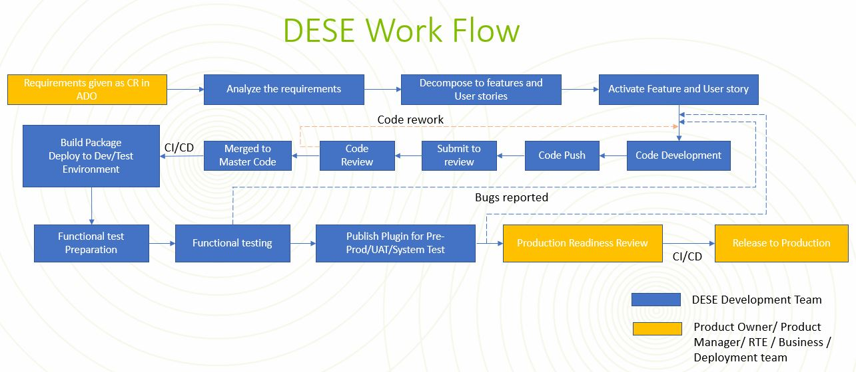
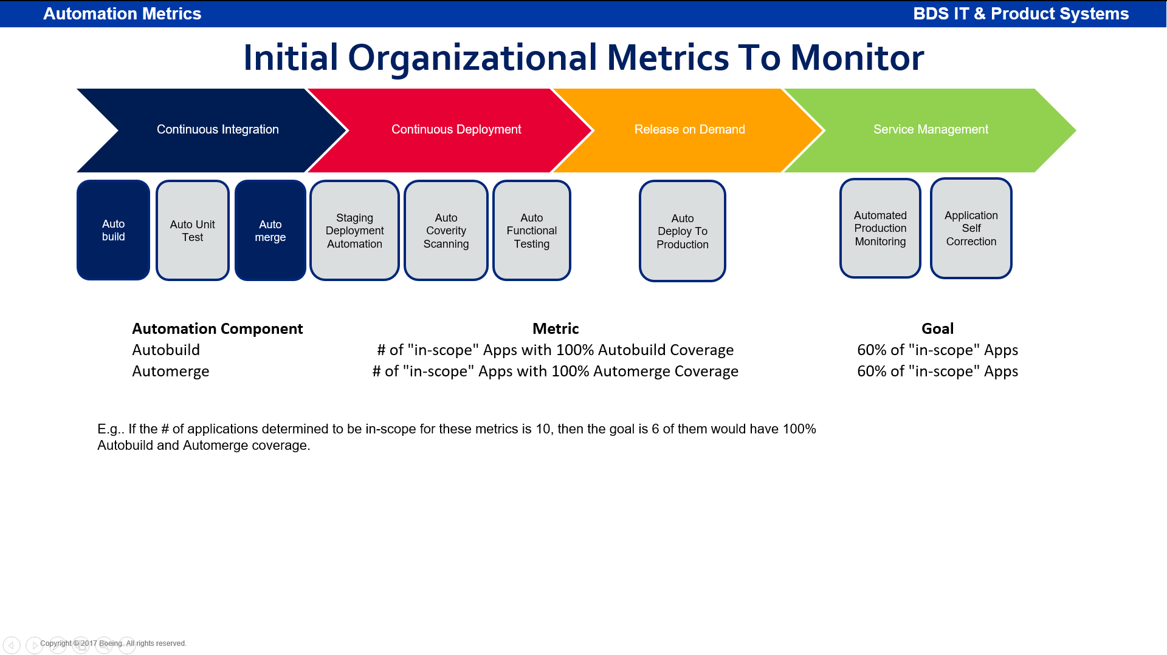
Automation Case study : 2
Project Name: DESE (Digital Environment for System Engineering)
Problem Statement: DESE creates solution, job aids, starter kit/models and training environment and deliver them to different Boeing Commercial and Defense Airplane programs and create an environment for integration with other MBSE tools like 3dxperience, Capital, etc.. They required tool to test plugin functionality, as manual testing was taking too much time
Solution: DESE learned that they could decrease the functional testing time by using IIR tool. Also they can reduce the manual build by CI/CD pipeline. This permits them to perform daily builds with automated FT which increased the output
Automation Hours Calculation:
The calculations for the of saved Automation hours:
Savings is 4 hours per build
DESE has 15 engineers actively working on code development on a daily basis by running the tests and making fixes to either the code and/or test procedures.
Hours saved formula: 322 build + 280 UT + 44 merge + 322 deployment + 106 coverity + 9920 FT = 11888 hours saved

Slide 24
Training and references

Slide 25
Training and support
Automation COP
https://devsecops.web.boeing.com/index.html [DevSecOps Website]
Training:
https://devsecops.web.boeing.com/trainings.html
https://insite.web.boeing.com/culture/viewMedia.do?mediaId=428840
Insite: DevSecOps related video series
Degreed: https://degreed.com/pathway/mpl66o5r9d/pathway
Oreilly: https://learning.oreilly.com/library/view/the-devops-handbook/9781457191381/
Enterprise Support
In case of any queries interested teams can register themselves through EMC (check for the session with the name “DevSecOps Office Hours (India)”).
For Product Teams in US, Click Here to block your slot
For Product Teams in India, Click Here to block your slot
DSO Support Systems | Description | URL
ATOMS | Platform to onboard to some of the commonly used tools like Coverity, Netsparker, SonarQube | https://atoms.web.boeing.com/home
ATOMS-CI | Saves your team time by generating an automated continuous integration pipeline and integrating different tools | https://atoms-ci.web.boeing.com/ci
DevSecOps | Official DevSecOps website | https://devsecops.web.boeing.com/index.html
AppDynamics | Monitoring tool documentation | https://itms.pages.boeing.com/wiki/appdynamics/
Enablement kit | Architecture Checklist to improve maturity | https://devsecops.web.boeing.com/assessment/enablementKit.html
DSO Mattermost channel | Join this channel for any questions/updates | https://mattermost.web.boeing.com/dso/channels/town-square
DSO Consultation | Connect with the experts | DL DSO Consulting
DSO COE InSite Group | Join this group for any questions/updates | https://insite.web.boeing.com/culture/viewGroup.do?groupId=168061
DevSecOps Video Library | Videos on different implementation | https://insite.web.boeing.com/culture/displayGroupMedia.do?groupId=168061

Slide 26
Contact us
 | DRI | Project Management | Core Team | Enterprise Team & Champions
DevSecOps | Abhishek Singh Kenneth C Shew | Pramithi R Karimpanakkal | Singh, Abhishek K Valiyarayil, Siby Pattanaik, Anup K Ammata, Sudhakar Bakhedi, Bharati Bahubali Balraj, Bharath K Ghosh, Saikat Ghosh, Subhabrata Gundupalli, Rajesh Reddy H D, Sarika K L, Bharath Karri, Ram Sai K-R, Rahul Kuriakose, Tintu M Kurian, Abhijith Kuruba, Kuruba Chandra Kumar Mistry, Ashok Nagaraju, Ganesh Nagziriya, Anshika Nair, Aathira Manikandan Padmanaban Shunmugam, Nihila Panda, Pritam Prabhat, Kumar Radhakrishnan, Chinjumol Reddy, V Sanjeev Rompicherla, Rakesh Sawant, Swapnil Ravindra Varghese, Jessy Vinukonda, Basha Jayanta Mondal DL Product Systems - DevSecOps Core Team | Karthik Tirukkoylur Sekhar Dolly Bhaskara Arun Prakash Jeyaprakash Anandapadmanabhan Gopalakrishnan Sushil Mishra Donald R Wellington Brennan Y Lind DL DSO DRIs
Automation | Kenneth C Shew Naga Harsha Kaggallu | Priyanka Dhanpal Chougule

Slide 27
Thank You

